Slide 1
IS-LM Model : Meaning, Components

Slide 2
What is the IS-LM Model?
The economic theories suggested by economist John Maynard Keynes in the 1930s can be described and explained through the IS-LM model. In 1936 when Keynes published their magnum opus, "The General Theory of Employment, Interest, and Money", economist John Hicks constructed the IS-LM model in 1937. IS-LM Model is a macroeconomic tool that shows the interaction between interest rates and production within the money market. This model highlights the main ideas of Keynesian economic theory and its full form is Investment-Savings and Liquidity Preference-Money Supply. In addition, it represents the equilibrium that emerges between real production and interest rates.

Slide 3
Components of IS-LM Model
The IS-LM model includes components such as monetary and fiscal policy, liquidity preference, and the balance between investment and saving:
Monetary Policy: This involves the central bank's management of the money supply and interest rates to achieve macroeconomic goals. It plays a pivotal role in influencing economic stability and controlling inflation.
Fiscal Policy: This encompasses government decisions on spending and taxation, directly impacting aggregate demand. It serves as a potent tool for policymakers to navigate economic conditions and stimulate growth.
Liquidity Preference: Reflects individuals' inclination to hold cash rather than invest it. This psychological aspect influences economic decisions and plays a role in shaping monetary policy.
Investment-Saving Balance: This represents the intricate relationship between savings and investment, a critical factor in understanding the impact of economic policies on investment decisions and overall economic growth.

Slide 4
IS Curve and LM Curve
The IS-LM Model comprises the IS Curve and LM Curve:
IS Curve:
The IS Curve outlines the correlation between real interest rates and output levels. It shows the impact of investment and government spending changes on AD (Aggregate Demand) and Economic Equilibrium. The shift in the IS curve directly impacts the equilibrium output level which can provide valuable insights to policymakers in fiscal policy changes.

Slide 5
The Figure shows the IS curve graphically. The goods market is shown on the left side and the IS curve is shown on the right side. The real GDP is shown on the X-axis and the real interest rate is shown on the Y-axis. This curve shows the equilibrium in the goods market at different real interest rate levels. A particular level of economic output is associated with each equilibrium. The real interest rate is in equilibrium when the saving and investment curves are the same.

Slide 6
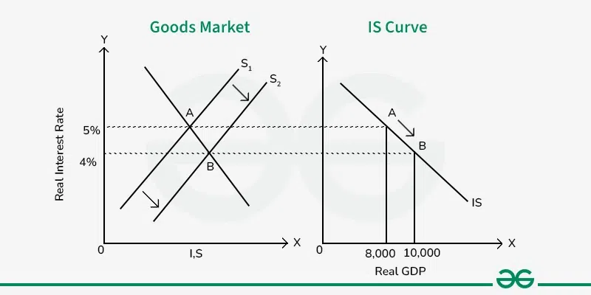

Slide 7
This can be better understood with an example. Suppose the real interest rate is 5%, and the output in the economy is 8000 units. Now, the output increases from 8,000 units to 10,000 units in an economy. The increased output increases the savings resulting in a shift from S₁ to S₂. This increase in savings leads to a decrease in the real interest rates. The new equilibrium shifts from point A to B, with higher output and lower interest rates. Due to this negative relationship between output and real interest rate, the IS curve is downward sloping.

Slide 8
LM Curve:
The LM curve shows the connection between central bank-induced interest rate adjustments and the equilibrium between nominal and real money supplies. When RBI changes interest rates and money supply, it can directly impact the position of the LM curve, influencing real income, output, and overall economic activity. LM curve can help policymakers maintain monetary equilibrium and promote sustainable economic growth.
Figure 2 shows the LM curve graphically. The assets market is shown on the left and the LM curve on the right. The real GDP is shown on the X-axis and the real interest rate is shown on the Y-axis. This curve shows the asset market equilibrium at different real interest rate levels. When the demand for money intersects with its supply, the asset market is in equilibrium.

Slide 9
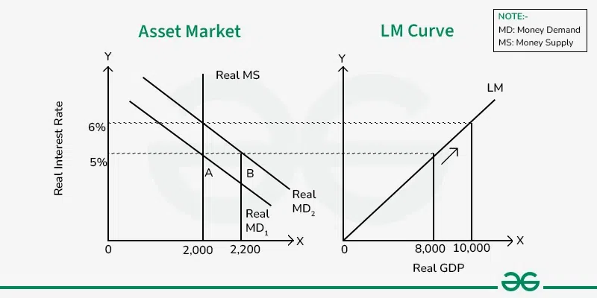

Slide 10
This can be better understood with an example. Let's suppose the real interest rate is 5%, the output in the economy is 8,000 units, and the money supply is ₹2,000 (which is also the money that a person wants to hold). Now, the output increases from 8,000 to 10,000 units in an economy. The increased output can increase the income level, which increases the spending and ultimately increases the demand for cash. This shifts the demand curve from left to right. The quantity of money increases from 2,000 to 2,200 but the supply is fixed at 2,000 which ultimately leads to a shortage of money in the economy. This increases the interest rate from 5% to 6%. Thus, there is a new equilibrium at 10,000 units and a 6% interest rate. Due to this positive relationship between the increase in output and real interest rate, the LM curve is upward-sloping.

Slide 11
How does the IS-LM Model Work?
The IS-LM model establishes a link between the determination of interest rates in the money market and the equilibrium level in the goods and money market. It also works on making a balance between savings and investments with the help of market forces. Interest rates play an important role in shaping the overall economic equilibrium. Several monetary policy tools such as open market operations can change the supply of money, which can influence interest rates. When the central bank makes changes in the money supply, it also has an influence on money market and goods market equilibriums. This can provide valuable insights while making policy decisions and making economic predictions.
Figure 3 shows the LM curve graphically. The equilibrium occurs at the intersection of IS (investment-savings) curve, LM (liquidity preference-money supply) curve and FE curve (Full employment). The equilibrium point shows the equilibrium in all the three markets; IS (goods market) curve, LM (asset market) curve, and FE curve (labour market).

Slide 12
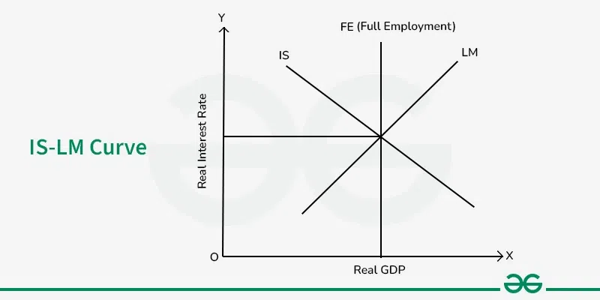

Slide 13
Difference between IS Curves and LM Curves in the IS-LM Model
Basis | IS Curve | LM Curve
Representation | It shows combinations of National Income (Y) and Interest Rates (r), where total spending equals total production. | It shows combinations of Interest Rates and Income (Y) where money supply equals money demand.
Derivation | It is based on the investment-savings relationship which shows how changes in interest rates can influence planned investment and national income. | It is based on liquidity preference-money supply which shows how changes in income can influence the demand for money.
Behavior | The IS model slopes downward because of a negative relationship between interest rates and planned investment. | The LM model slopes upward because of a positive relationship between income and the demand for money.

